Slide 1
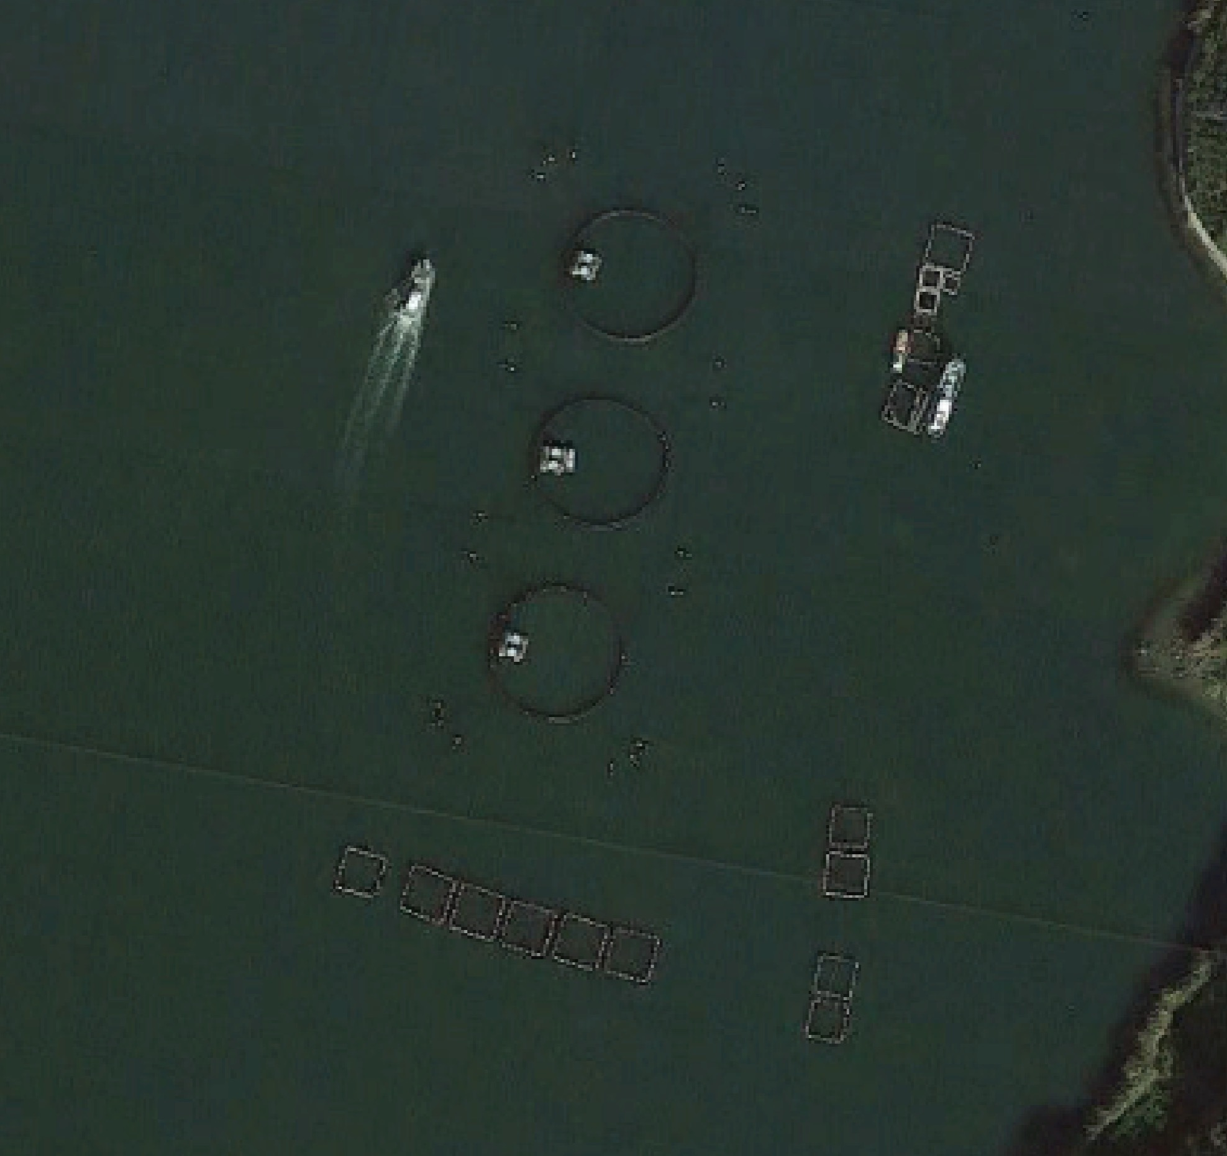
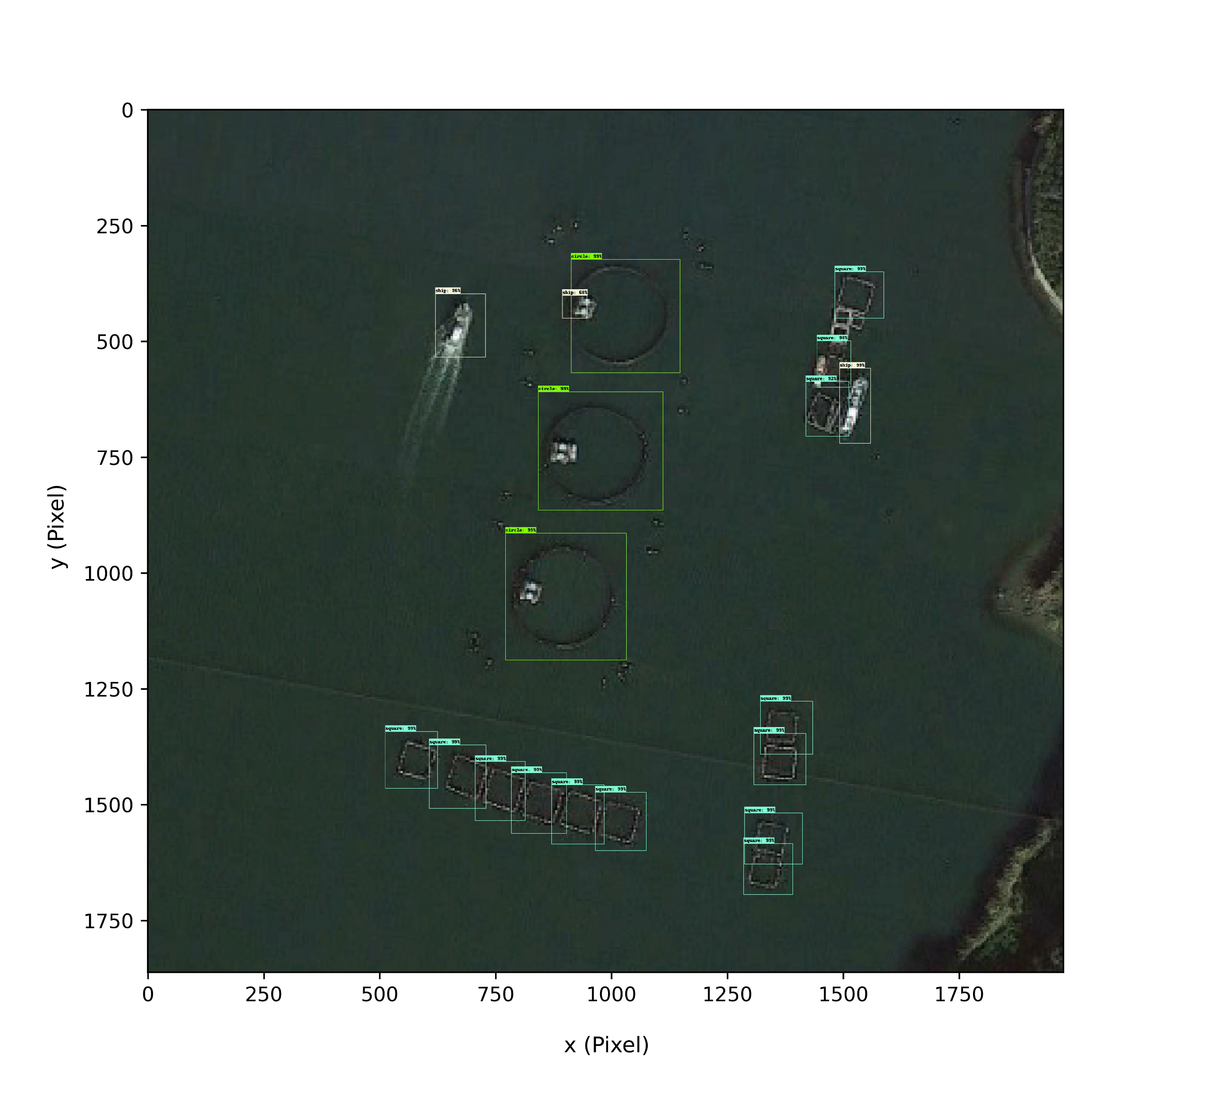
Satellite image input
Object classes name
Object position
Bounding box size
TF-Faster R-CNN
Object detection result
Bounding box with object classes name

Slide 2
Satellite image input
Object classes name
Object position
Bounding box size
TF-Faster R-CNN
Object detection result
Bounding box with object classes name

